Slide 1



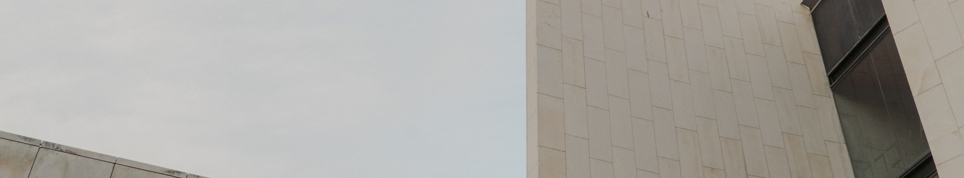

Add company name here | MM/DD/YYYY
This presentation has live captioning
SOCIAL MEDIA PLATFORM
name of project:
Idea Share
presented by:
Maja Kadic, Calvin Kwok, Paul Bronola

Slide 2




Login/Registration
Agenda
Newsfeed
Idea Creation
Profile
Private Messages

Slide 3




Overview
Idea Share is an innovative social media app that provides a platform for users to freely share, collaborate, and explore ideas.
Audience
Features
User Experience
To succeed with our app, we focused on the target audience consisting of Gen Z, Millennials, Professionals, Entrepreneurs, Artists, and Creatives within today’s diverse audience landscape
Idea Share offers a dynamic platform for users of all backgrounds, to easily share and collaborate on ideas using intuitive tools to foster a vibrant community of intellectual growth and creative inspiration
Our app provides a personalized user interface, interactive features like direct messaging, and seamless integration of multimedia content to enable users to express and refine their ideas and connect them with like-minded individuals

Slide 4


User
Statement of Problem:
We want to offer users a platform where they can freely share, collaborate, and explore ideas with the intention of nurturing a creative community through a seamless personalized user experience that fosters intellectual growth and inspiration
General Requirements:
Providing intuitive tools for idea creation and communication, the app encourages an exchange of thoughts, thereby nurturing a community that thrives on intellectual growth and creative inspiration. The Idea Share app offers a personalized user experience with features like user registration, multimedia idea sharing (posts, likes, comments, and photo sharing), direct messaging, and real-time notifications
Inputs:
Posts/Ideas in the form of text and images, search results for desired content, profile page customization, and direct messaging to other users
Outputs:
Appealing posts/ideas for others to view, comment, and contribute, customized profile page, and communication with other users

Slide 5
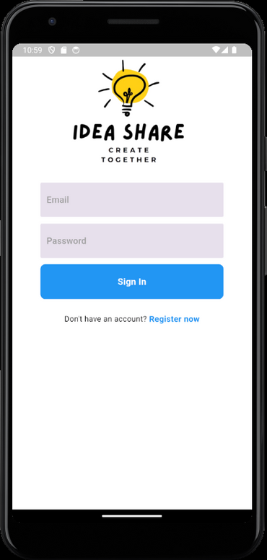

Design - Login/Registration
Design Features & Code Snippets
Description:
When users open the Idea Share app, they are presented with a splash screen that welcomes them. The user is then transitioned to the Login screen and can toggle to the Registration screen
Functionality & User Experience:
The user is met with a sleek splash screen and transitioned to the Login Screen where users can sign in with an existing account or toggle to the Registration Screen to make an account
Code Snippet
Future<UserCredential> signUpUser(String email, String password) async {
try {
UserCredential userCredential =
await _firebaseAuth.createUserWithEmailAndPassword(
email: email,
password: password,
);

Slide 6
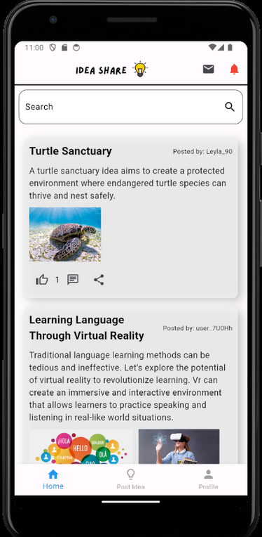
Design - Newsfeed
Design Features & Code Snippets
Description:
The Idea Share central hub provides a comprehensive view
of community activities and ideas
Functionality & User Experience:
The central hub offers users a dynamic experience with a feed of ideas including functions for searching, liking, commenting, and sharing. Navigate to other functionalities of the app such as posting, direct messaging, and the profile tab with a click of a button
Code Snippet
Expanded(
child: StreamBuilder<QuerySnapshot>(
stream: FirebaseFirestore.instance
.collection('ideas')
.orderBy('timestamp', descending: true)
.snapshots(),
builder: (BuildContext context,
AsyncSnapshot<QuerySnapshot> snapshot) {

Slide 7
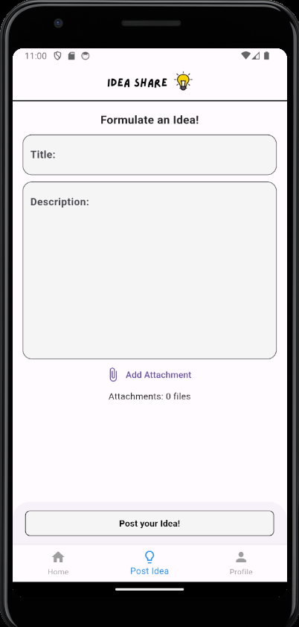
Design - Idea Creation
Design Features & Code Snippets
Description:
This interface is user-friendly and allows users to create
and share their innovative ideas
Functionality & User Experience:
Users can create and upload new ideas by providing a title, description, and attachments before posting by clicking the
“Post your idea!” button
Code Snippet
final storageRef = FirebaseStorage.instance.ref();
for (int i = 0; i < attachments.length; i++) {
final file = attachments[i];
final fileName = '${DateTime.now().millisecondsSinceEpoch}_$i';
final uploadTask =
storageRef.child('attachments/$fileName').putFile(file);
final snapshot = await uploadTask.whenComplete(() {});

Slide 8
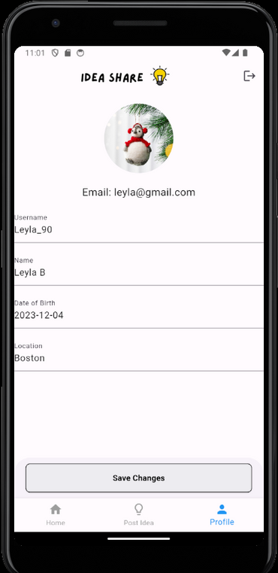
Design - Profile
Design Features & Code Snippets
Description:
A dedicated screen that displays the user's email and allows
users to make changes to their profile details
Functionality & User Experience:
Users can edit their profile details such as the profile avatar, username, date of birth, and location after pressing the “Save Changes” button. Pressing the profile avatar will allow you to
choose a photo from your device or Google Drive
Code Snippet
Future<void> updateProfile() async {
try {
if (_image != null) {
String fileName = 'profile_${currentUser!.uid}';
var storageRef = FirebaseStorage.instance.ref().child(fileName);
await storageRef.putFile(_image!);
String downloadUrl = await storageRef.getDownloadURL();
currentUser!.profileImageUrl = downloadUrl;

Slide 9
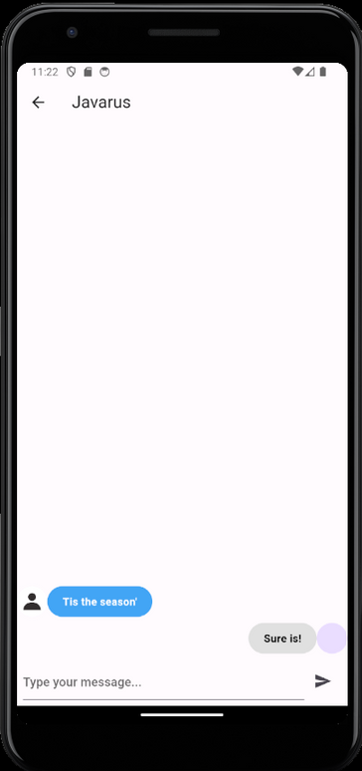
Design - Private Messages
Design Features & Code Snippets
Description:
A display screen that exhibits a list of individual conversations through private messages between other users within the application
Functionality & User Experience:
Users can privately interact by viewing an replying to messages, promoting collaboration and increasing interactions
Code Snippet
Stream<List<Message>> getMessages() {
return _firestore
.collection('conversations')
.doc(widget.conversationId)
.collection('messages')
.orderBy('timestamp', descending: true)
.snapshots()
.map((snapshot) =>
snapshot.docs.map((doc) => Message.fromFirestore(doc)).toList());

Slide 10





Testing and Refinement
Issues
Resolution
Comments section not working
Dashboard could only handle one post
Implementing all the files together
Moved comments to a separate screen
Made dashboard scrollable
Changes to the individual files

Slide 11


Future Features
Addition of video sharing
Improvements to the User Interface, such as adding a Dark Mode
Idea editing options and user suggestion “box”
Idea categorization and filtering options

